Slide 1




GAJA SANRAKSHANA PROJECT IN ODISHA
Activities 2024-25
Implementation Partner – SNEHA NGO

Slide 2
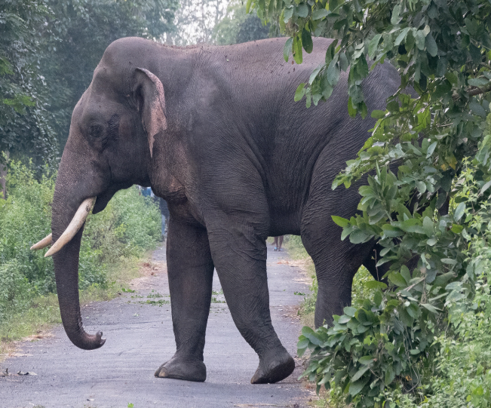
About Gaja Sanrakshana Project in Odisha
Gaja Sanrakshana in Odisha focuses on hotspots around elephant reserves and corridors. It aims to reduce casualties through on-the-ground technical and educational interventions, collaborative efforts with the wildlife and forest departments, and habitat conservation to ensure a healthy elephant population in the State.
Tata Power's aim in elephant conservation is not only to minimize electrocution deaths but also to preserve and facilitate an increase in their Indigenous populations by lowering natural and unnatural deaths due to various diseases, poaching and preventable accidents, creating a more conducive environment for them in their natural corridor.

Slide 3
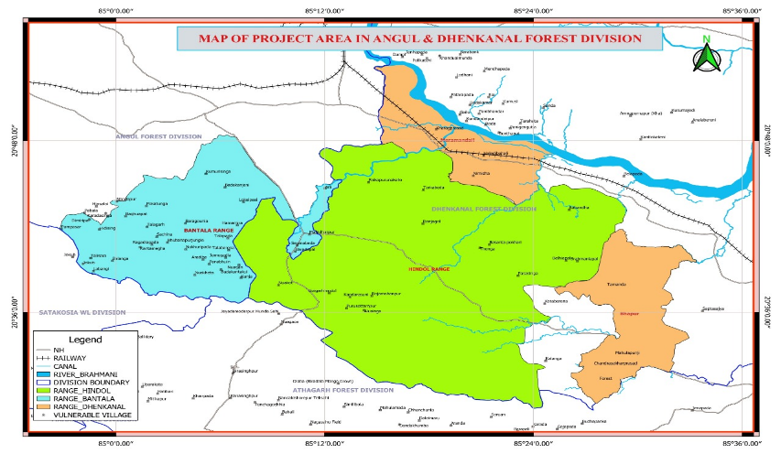
Focus on Hotspots & Conflict Areas
Project Initiation – Map Showing Geographical Details of Initial Project Area
  The project specifically targets elephant conflict hotspots around elephant reserves and corridors in Odisha, particularly in the Bantala Range, Angul,and Hindol & parts of Sadar ranges in Dhenkana.

Slide 4
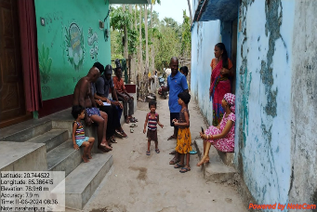
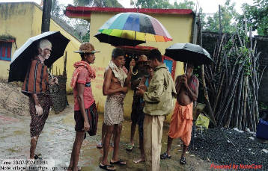
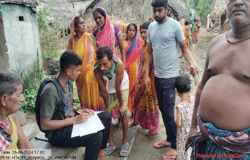
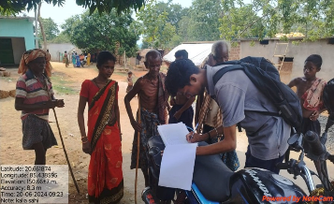
Need Assessment
A needs assessment was conducted in collaboration with 6,412 farmers across 250 villages, facilitating further collaboration and convergence with various development activities, particularly in areas affected by human-elephant conflict.
Survey in progress in Hindol Section
Survey continuing during monsoon in Bantala
Survey in progress in Khajuriakata section, Hindol
Survey in progress in Bampa Section, Hindol

Slide 5
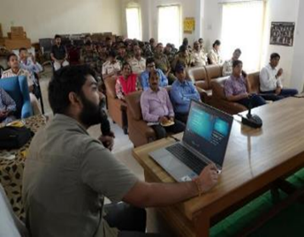
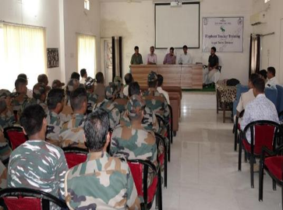
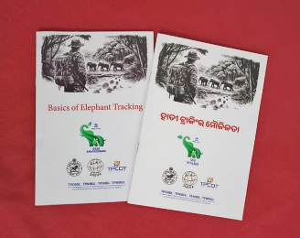
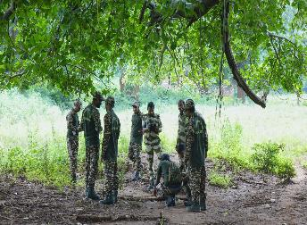
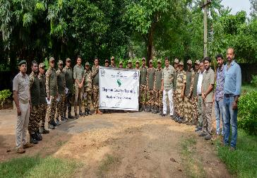
Training of Elephant Squads
123 elephant squads were trained in elephant behaviour and tracking techniques to help track and manage elephant movements effectively, improving safety for both humans and elephants. 20 of them were shortlisted to become expert trackers.
Basic Training in progress by WII Trainer
Basic Training in progress
Elephant Tracking in Odia & English
Practical session during Basic Training
A group photo after the Basic training

Slide 6
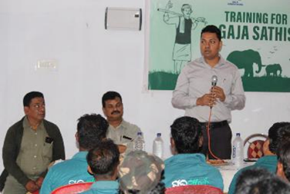
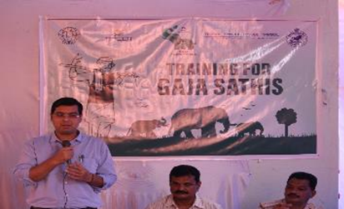

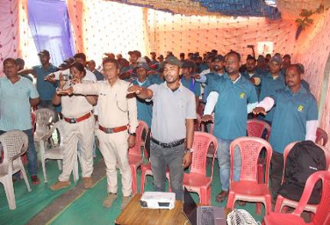
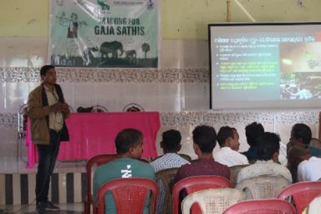
Gaja Sathi Training
972 Gajasathis were trained to work with the Forest Department and raise community awareness to protect elephants. Training was facilitated through a dedicated training booklet.
DFO-Dhenkanal at one of the training sessions
DFO-Angul at one of the training sessions
HEC Manual for Gaja Sathis
Oath taking in progress in the Bantala range
Training session in progress

Slide 7
Electrocution Threat Mapping
A systematic electrocution threat mapping was undertaken, with TPCODL’s technical team addressing identified threats and minimising risks to elephants from electrical hazards. The data and information were collated, entered into Excel sheets, mapped using GIS, and shared periodically until the end of January 2025 with the two Divisional Managers of TPCODL and the DFOs of Dhenkanal and Angul.
Solar Powered Fencings – 447 points were reported, of which 166 were in Angul and 281 in Dhenkanal. Such fences were reported as most of them were of poor quality and susceptible to electrocution.
(2) GI Wire Fencings – 302 points were reported, of which 147 were in Angul and 155 in Dhenkanal. Such fences are liable to be charged from a domestic source or an LT power line.
(3) Unbarricaded Transformers -196 points were reported, of which 97 were in Angul and 99 in Dhenkanal. Such transformers can be a source for hooking a live wire for poaching or fencing.
(4) Sagging Overhead Powerlines – 32 such points were reported of which seven were in Angul and 25 in Dhenkanal. Most of the sagging lines were rectified quickly in Angul, while some continue to exist in Dhenkanal.
(5) Live Wire for Poaching – 52 locations have been identified and reported, of which 13 are in Angul and 39 are in Dhenkanal. Such locations are regular hot spots and are reported along with the nearest power source.

Slide 8
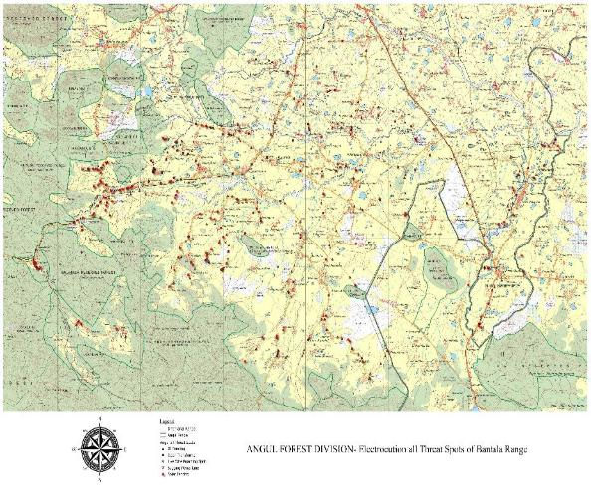
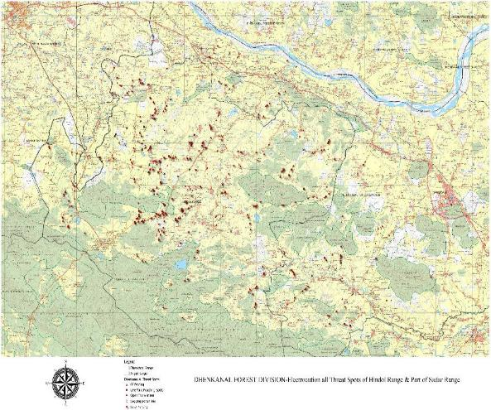
Prevention of Electrocution – Map Showing Threat Spots in Bantala Range, Angul
Prevention of Electrocution – Map showing Threat Spots in Hindol & Sadar Ranges, Dhenkanal

Slide 9
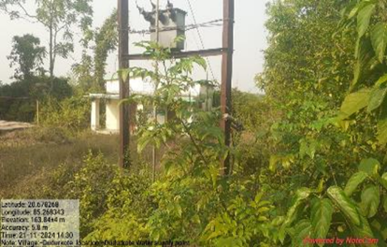
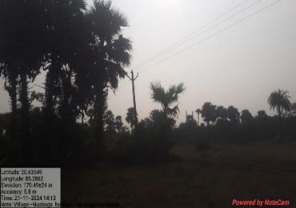
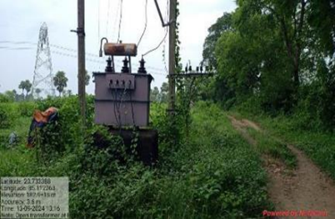
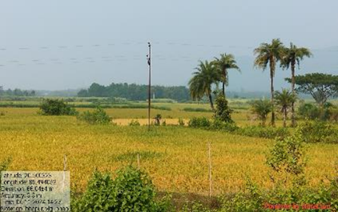
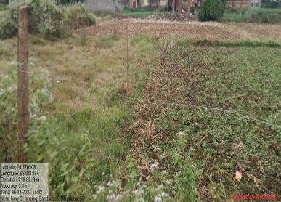
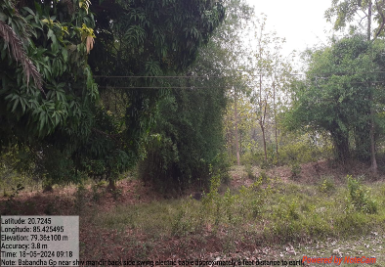
Prevention of Electrocution – Identified Threat Spots
An unbarricaded Transformer
One of the many Live Wire Poaching spots
An Open transformer
A solar powered fence
A fence made of GI Wires
A Sagging Overhead Powerline

Slide 10
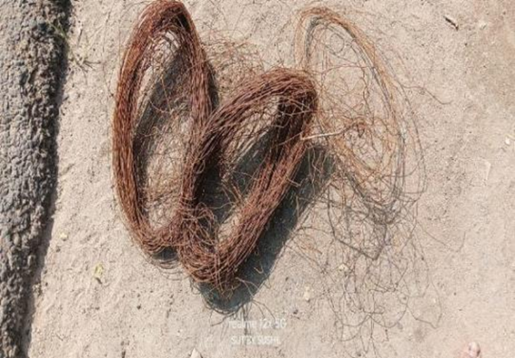
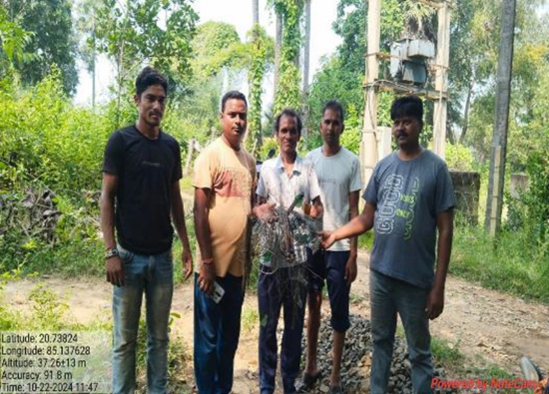
Grassroots-Level Intelligence Network
A grassroots-level intelligence network was established to track illegal power traps, identify vulnerable spots, and inform Forest Department & TPCODL, significantly enhancing the monitoring and protection of elephants.
GI Wires for Live Wire Poaching seized from Khinda Section & Khanja Section of Bantala range

Slide 11
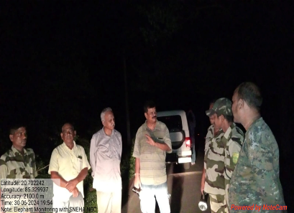
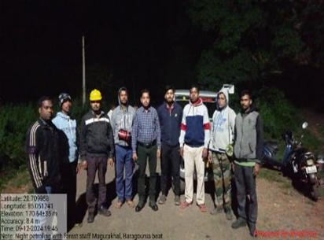
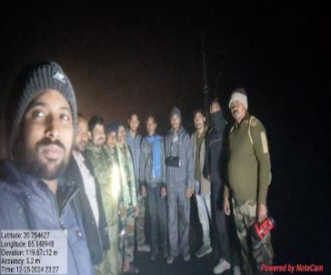
Prevention of Electrocution : Intelligence Network & Active participation in Joint Patrolling
Active Participation in Joint Patrolling - Before the project’s initiation, joint patrolling between the Forest Department and TPCODL staff was a regular occurrence. However, with a list of threat spots shared by SNEHA, the patrolling became more intensive in vulnerable hotspots. The project team participated in joint patrolling trips, which resulted in a more focused and adequate exercise. Over the last ten months, SNEHA’s Field Staff have participated in over 460 night patrolling trips in their respective areas and across the project area.
Night Patrolling in Hindol Range,
Dhenkanal
Night Patrolling in Bantala Range,
Angul
Night patrolling in Hindol Range,
Dhenkanal

Slide 12
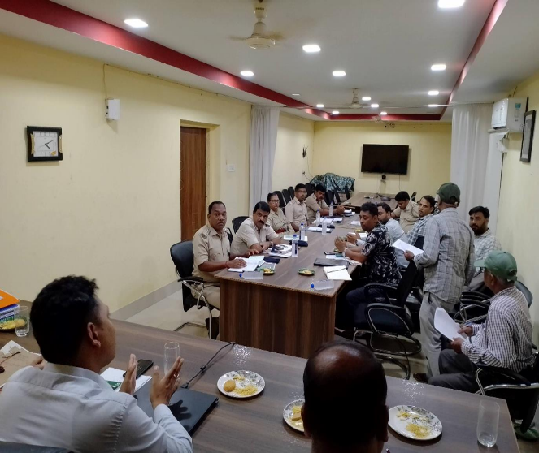
Coordination Meetings between Forest Department & Tata Power
Coordination Meetings were held between the Forest Department and the Discoms at the State, Division, and range levels. As a partner NGO to the Forest Department and a partner of Tata Power, SNEHA was invited to most meetings, both virtually and in person.
SNEHA actively participated in Division and Range-level meetings, contributing crucial data and information to prevent electrocution, and also organized meetings to bring the two together at the staff level, including contractual staff.
For the first time, the Forest Guards and foresters, along with some members of the Elephant Squad from the Forest Department and the SDO, JE, and Linemen from TPCODL, were brought together in a formal meeting in Bantala and Hindol to coordinate their efforts. This meeting proved to be a crucial one, with the Line men also being offered rewards for providing intelligence reports.

Slide 13
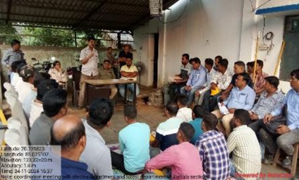
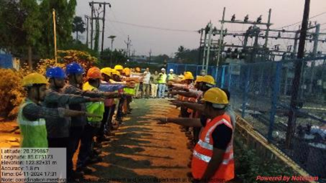
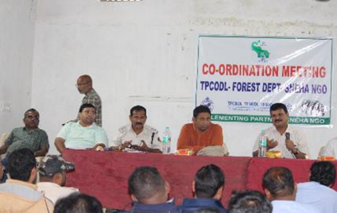
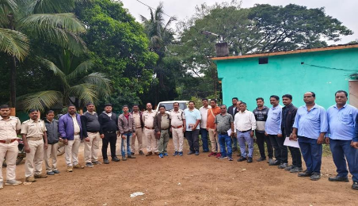
Coordination Meetings between Forest Department & Tata Power…contd..
Meeting at TPCODL’s JE-Bantala’s Office
Oath taking during meeting at JE-Bantala’s office
Meeting between Hindol Range & TPCODL Staff
Meeting at Balimi, Hindol Range, Dhenkanal

Slide 14
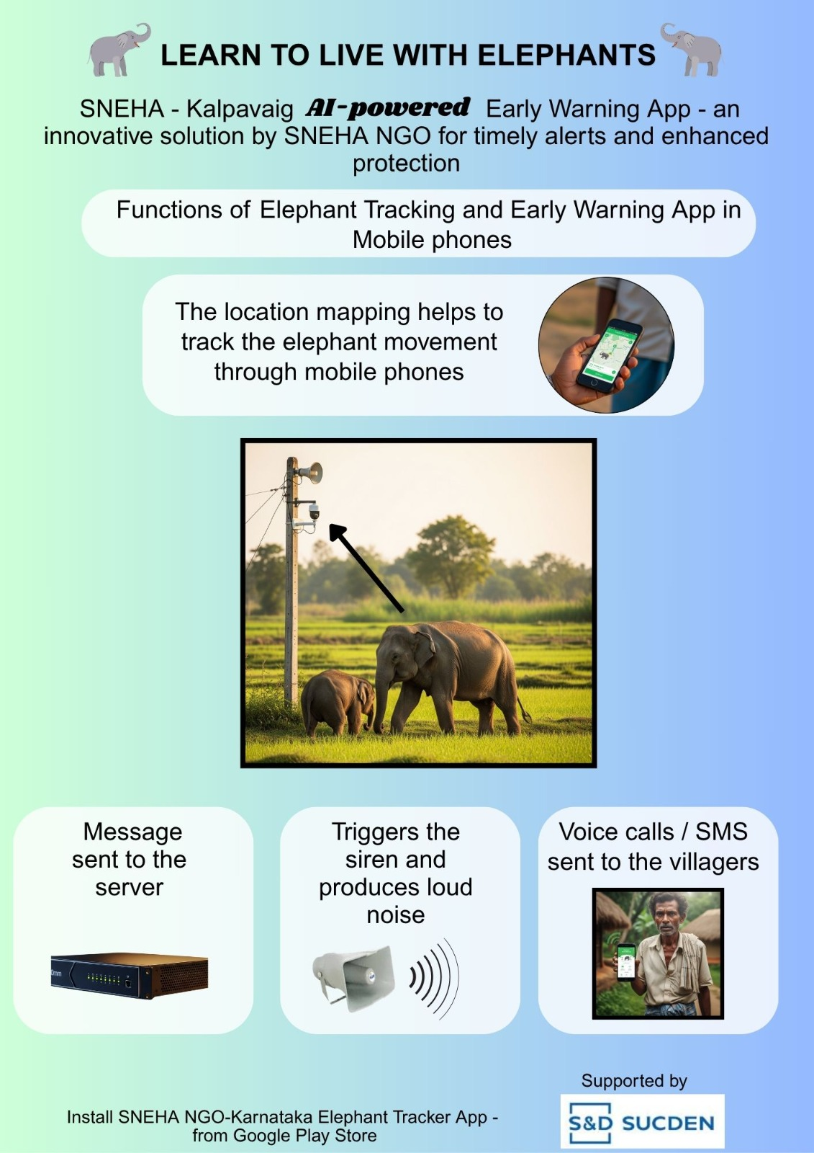
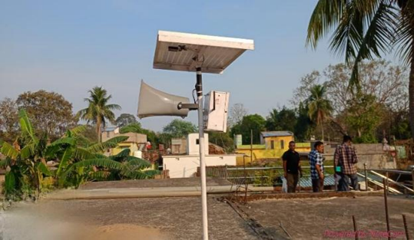
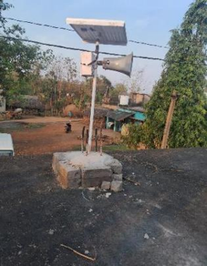
Early Warning System
The project developed a unique early warning system using WhatsApp and mobile apps with AI capabilities. This system alerts communities about elephant movements through messages, calls, and sirens.
Hooter fixed on a roof top in Thokar, Hindol
Hooter fixed on a rooftop in Nua, Hindol.

Slide 15
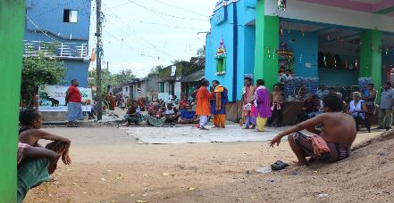
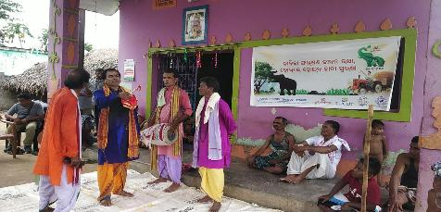
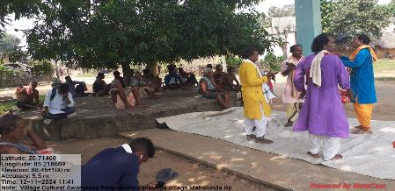
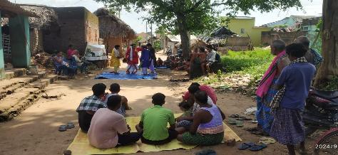
Awareness Programmes
Street Plays
365 local folklore shows were held in 205 villages near forests, along with wall paintings to raise awareness. These programs were particularly effective in educating local communities about elephant conservation.

Slide 16
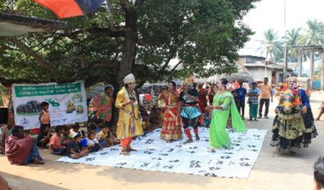
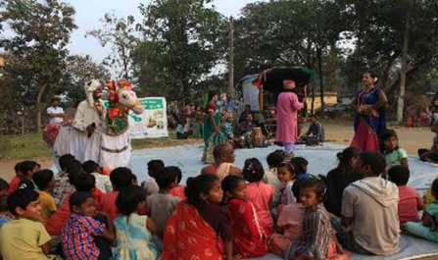
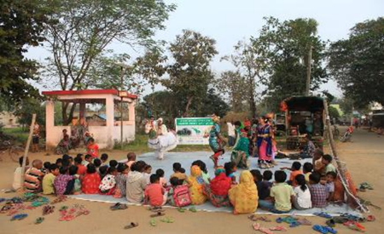
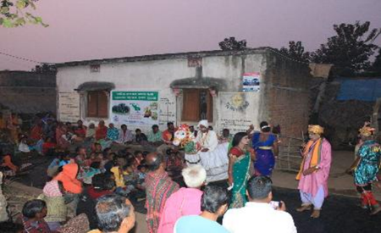
Street Plays – awareness through traditional Ghoda Nacha art form …contd…

Slide 17
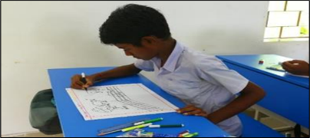
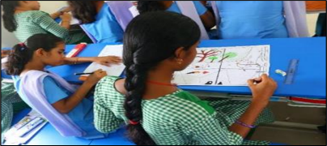
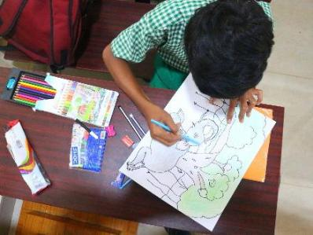
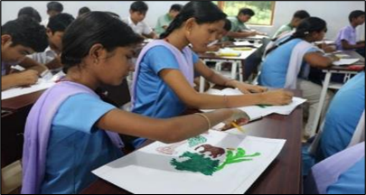
Awareness Campaigns for School Students
World Elephant Day & Wildlife Week Celebrations :
World Elephant Day was celebrated on 12th August,2025 in a grand way in six schools of Hindol Block. About 1900 students got directly or indirectly involved in the event to make people of the region aware of the importance of the day and motivate the society to work towards Human-Elephant Co-Existence.

Slide 18
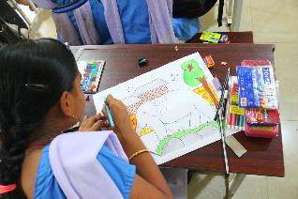
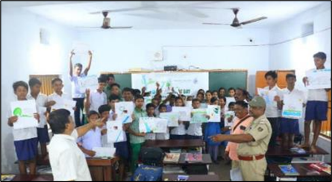


Awareness Campaigns for School Students - World Elephant Day Celebration …contd…
Competitions

Slide 19



Awareness Campaigns for School Students - World Elephant Day Celebration …contd…
Competitions

Slide 20




Panchayat & Village level Community Meetings
Panchayat-level meetings were conducted to reduce the human-animal conflict and prevent illegal hooking and live wire for poaching in the villages.
DFO-Dhenkanal at Bhimbori’s Community Meeting
Project-in-charge at Nabakishorepur Meeting
Meeting with villagers of Sisukata
Meeting with villagers of Bantol

Slide 21




Community Meetings – Panchayat & Village level
DFO-Dhenkanal at Bhimbori’s Community Meeting
Project-in-charge at Nabakishorepur Meeting
Meeting with villagers of Sisukata
Meeting with villagers of Bantol

Slide 22



Community Meetings – Panchayat & Village level
Meeting with villagers of Hindol Block
Meeting with villagers of Loharpada
Meeting with villagers of Lokeiposi

Slide 23
Sensitizing Social Media Groups & Media Professionals
WhatsApp Groups :
On a request by DFO, Dhenkanal, the Group Admins of three local WhatsApp groups were called for a meeting to raise their awareness. While appreciating their role in cautioning locals about the presence and movement of elephants on roads and near villages to prevent loss of life and property, the adverse effects of their postings were also pointed out. The postings of photos and descriptions of Tuskers could attract ivory poachers. The presence of elephants attracts young people to the spot, who harass them, resulting in human casualties elsewhere, often among the elderly. Finally, graphic photos of human deaths agitate the public and aggravate their resentment towards elephants.
Media Professionals :
A workshop was organised by IIMC (Indian Institute of Mass Communication), Dhenkanal, in association with the Dhenkanal Forest Division, in which SNEHA also participated. The half-day session covered a presentation on elephant behaviour and ecology, as well as key suggestions to avoid negative interpretations.

Slide 24


Sensitizing Social Media Groups & Workshop for Media Professionals
Meeting with Social Media – WhatsApp groups of Hindol
Meeting with Media professionals of Dhenkanal

Slide 25


Awareness Campaigns ….contd…
Wall Paintings :
Wall Paintings were done at 18 locations in the project area. The theme and content of the paintings was to dissuade the youth in the area from chasing, teasing and harassing elephants as stress and resentment among the elephants will result in attacks on innocent old people.

Slide 26


Convergence Workshops
  Workshops were held at the district and block levels, with information disseminating down to the Gram Panchayat level. This created a strong rapport with the local community and the Forest Department.
District Level Convergence Workshop in progress
ED-SNEHA presenting the Household Survey Findings

Slide 27




Convergence of Govt Departments to mitigate HEC – Block level
Presentation of survey findings in progress
Unveiling the Poster on HEC mitigation
Line Departments of Hindol Block at the meeting
Line Departments of Angul Block at the meeting

Slide 28

Convergence of Govt Departments to mitigate HEC
First Convergence activity
Handing over Chicks for backyard Poultry
SNEHA did a survey of remote villages in Hindol Range and shortlisted beneficiaries to augment their incomes in three villages of Dandiri Panchayat, Hindol range of Dhenkanal and approached the concerned government department for necessary support.
A total of 131 beneficiaries (61 Gen, 47 SC, 22 ST, and 1 OBC category, 75 women and 56 men) received 2,620 Banaraj chicks (20 per beneficiary) along with financial support of ₹1,000 per beneficiary for poultry shed construction.
This assistance was provided under the Rural Backyard Poultry Rearing Scheme (State Plan 2024-25) through an intersectoral convergence program with the Fisheries and Animal Resource Development Department (FARD) in Hindol block, Dhenkanal district.

Slide 29

Elephant Profiling -86 Nos Completed
Elephant Profiling is the process of Individual characterisation of elephants based on certain unique morphological features. Combining and comparing one or more features will separate elephants into individuals. Profiling can be used to mark and track elephants based on their conflict history and behaviour.

Slide 30



Diagrammatic Representation of Data
Diagrammatic representation of the elephant helps quickly identify the individual projecting unique characters. Such representation is crucial while radio collaring, which makes clear-cut spotting of the animal.

Slide 31

Age Group: Prime Adult:
Above Age 30 Years
Sex: Male
Footprint Perimeter: 154 CM
Approximate Height:
10 to 10.5 Feet

Slide 32
Key Outcomes
Save Human and Elephant Lives
Reduction in human-elephant conflict, primarily through prevention of electrocution.
Strengthened community involvement and awareness around elephant conservation.
Innovation in early warning systems and training programs, leading to better protection measures for elephants and local communities.
School Children become change agents

Slide 33

Appreciation from the Regional Conservator of Forest
RCCF Angul Region

Slide 34
Moving Forward – Expansion plan to other regions
SNEHA, with consent from the Forest Department and approvals from Tata Power plans to expand the project areas –
More areas in Current Forest Divisions coming under TPCODL – The next two years would see
some of the project activities getting replicated in two more ranges of Angul Forest Division –
Talcher & Angul-Sadar and two more ranges of Dhenkanal Division – Mahabirod and
Kamakhyanagar West.
(2) More forest divisions from the JTF’s Comprehensive Action Plan located in the other three
DISCOMs. The following ranges are being proposed –
  Baripada Division – Rasgovindpur & Betnoti Ranges
  Bonai Division – Koida Range
  Sambalpur Division – Sambalpur-Sadar Range
  Keonjhar Division – Champua & Keonjhar-Sadar Range
  Ghumsur North Division – Mujhagada, Tarsing & Galery Ranges

Slide 35

Going Forward – Expansion to other regions – Map showing proposed Ranges

Slide 36


